Slide 1
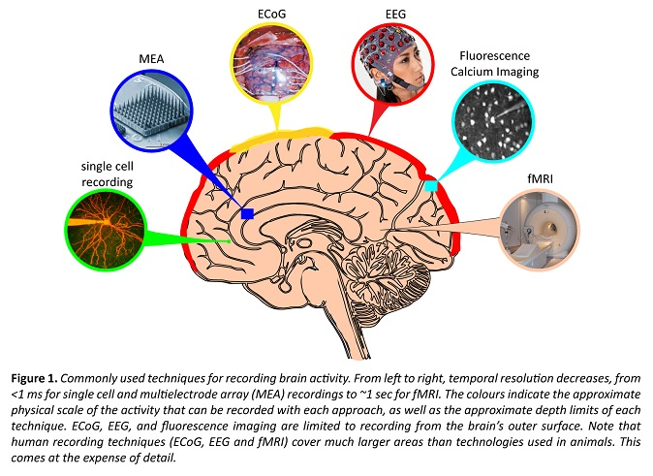

MEG
MagnetoEncephaloGraphy

Slide 2
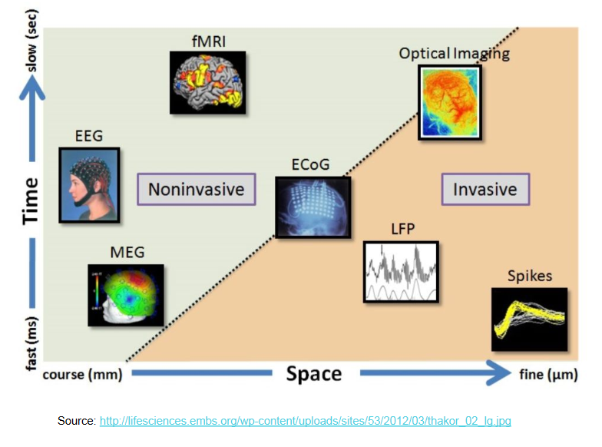
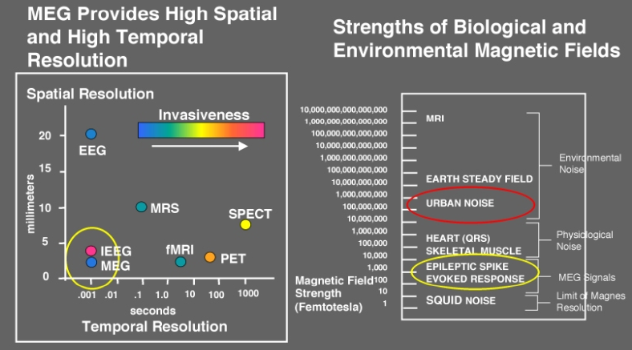
Properties of MEG
Notes:
MEG is a non-invasive technique for investigating/recording human brain activity.
It allows the measurement of ongoing brain activity on a millisecond-by-millisecond basis.... (i.e., high temporal resolution ideal to follow brain changes over time)

Slide 3
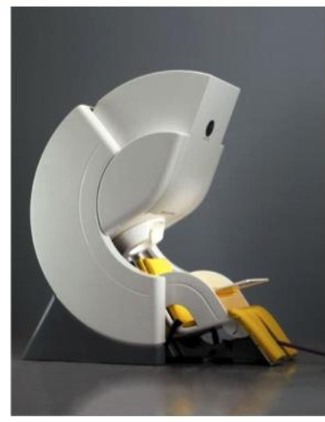
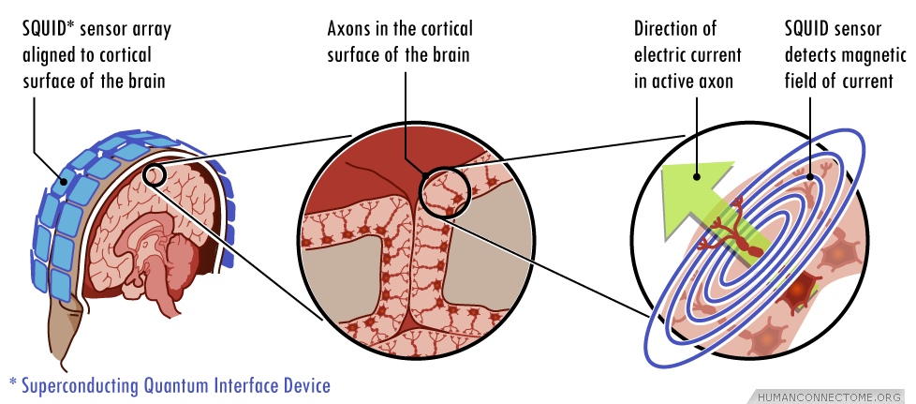
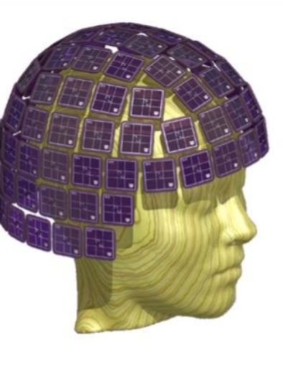
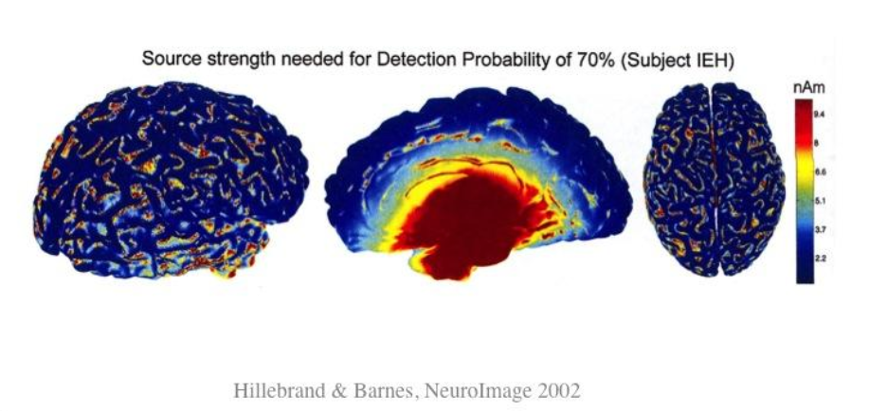
Notes:
Electric current created by neuronal activity generates magnetic field recorded by the MEG sensors (gradiometer, magnetometer)
superconducting sensors (SQUID, superconducting quantum interference device)

Slide 4
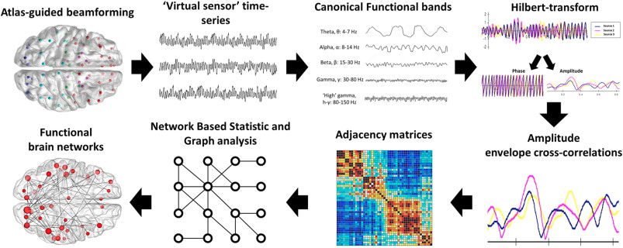
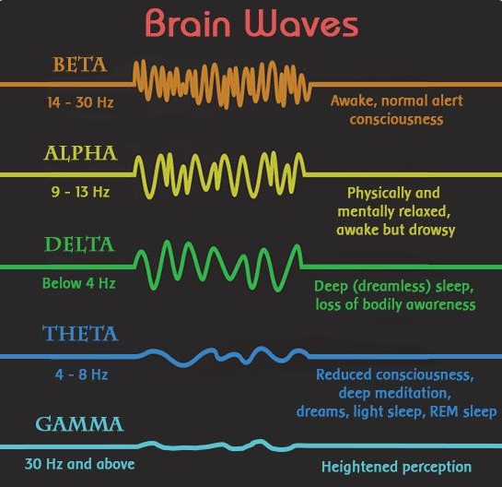

Slide 5
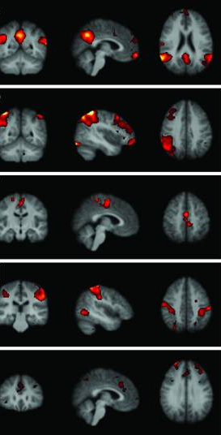
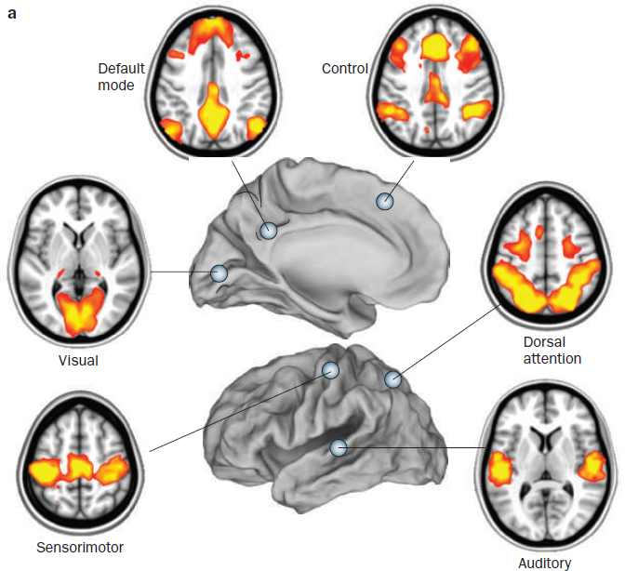
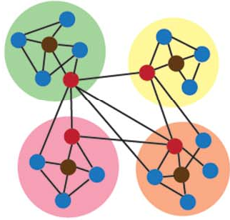
Methods for analyzing the brain as a network
A) Independent component analysis
B) Seed-based correlation analysis
Zhang and Raichle,
(2010). Nat Rev Neurol
C) Graph theory analysis
Damoiseaux et al., (2006).
Proc Natl Acad Sci USA
Notes:
The most popular techniques for analyzing the brain as a network from resting-state fMRI include independent component analysis, seed-based correlation and graph theoretical approaches used in the present paper to study network dynamics.
In seed-based correlation, the signal is extracted from a specific region of interest and its temporal profile correlated with that of all other brain voxels. ICA is a data-driven approach that considers all activated voxels and groups them into clusters that are correlated with their spontaneous fluctuations.

Slide 6
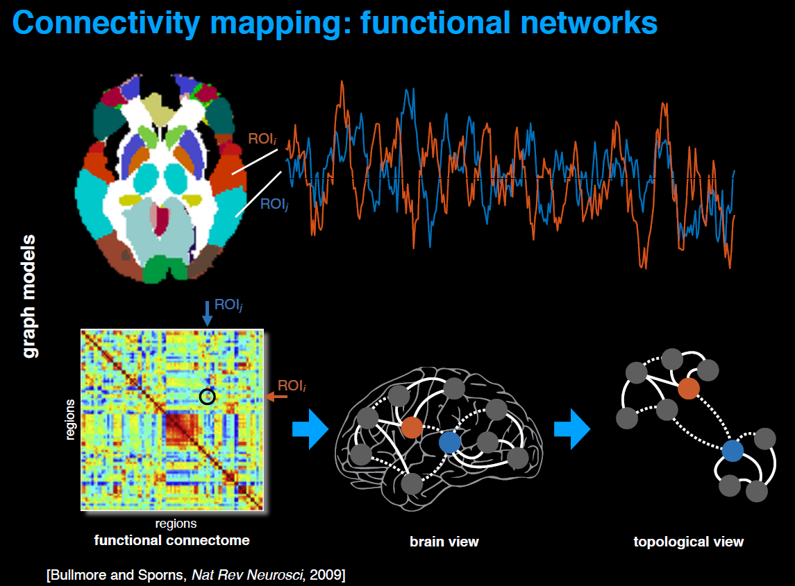
Credit:SfN18-dynFC_Van de ville

Slide 7
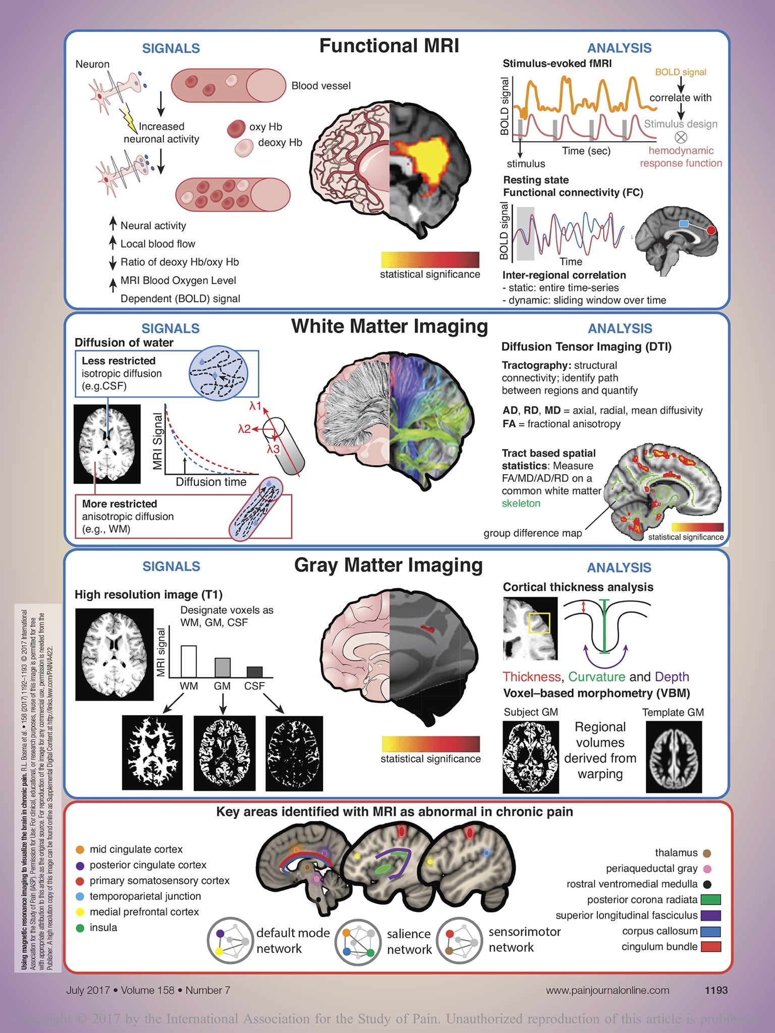
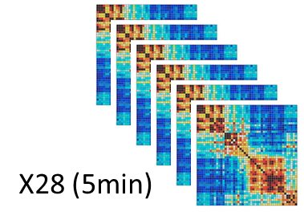
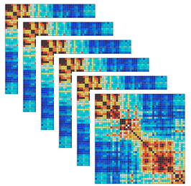
MEG preprocessing – main steps
X6 (Frequency band)
……

Slide 8
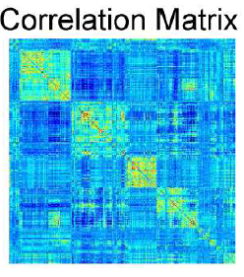
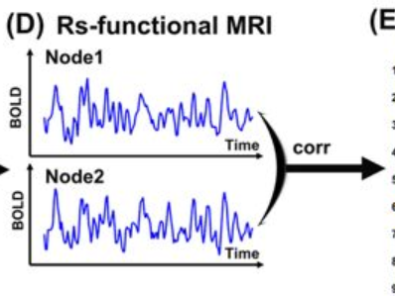
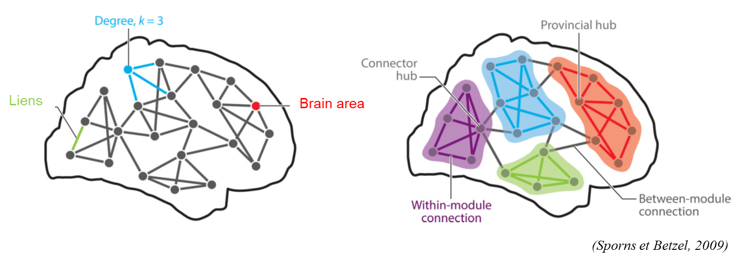
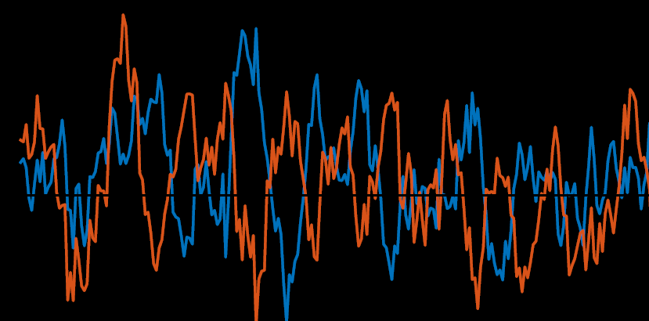
Static Modularity
The brain is an inherently dynamic system
Functional connectivity (FC) establishes summary statistic over the whole (resting-state) run
Average behavior and insensitive to temporal order
Need to acknowledge time-varying features of FC
Notes:
The goal is to compute metrics able to reflect normal brain organization fluctuations over time using graph theory.

Slide 9
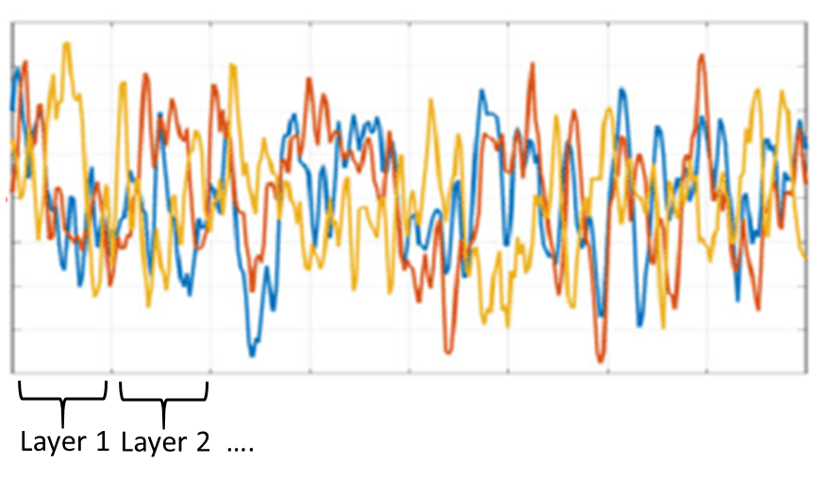
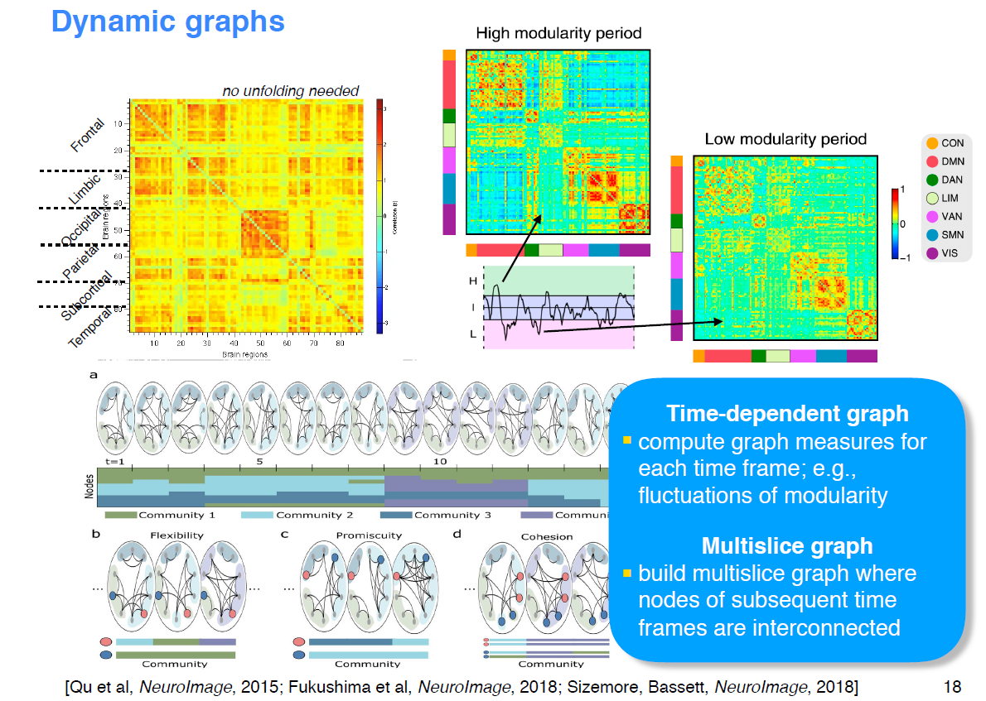
Dynamic Functional Connectome:
Time series
Credits:SfN18-dynFC_Van de ville

Slide 10
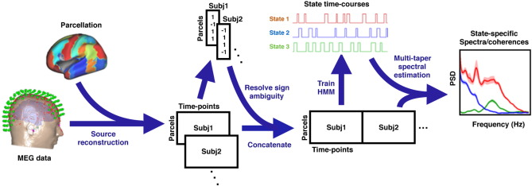
How can we summarize time-resolved graph information?
Dynamic Functional Connectome:
1
Modularity detection over time (multi-layer community detection)
Lab of D. Basset (see Mucha et al. 2010)
2
Temporal Models (Hidden Markov Models)
Vidaurre et al., 2018. NatComm
Lab of M. Woolrich (OHBA)
Notes:
The goal is to compute metrics able to reflect normal brain organization fluctuations over time using graph theory.
Point 1:
To identify the community structure of this multislice network, the identity of each node is imposed by adding interslice connections (dashed lines) between identical nodes across slices. (B) Using a dynamic network clustering approach known as multislice community detection (see Methods), we extract the community structure of the network for each individual task. Each community is represented by a different color. (C) The module allegiance matrix conveniently summarizes the community structure of the network across tasks. Each entry i, j of the matrix corresponds to the percentage of tasks in which regions i and j belong to the same community, describing how regions (A 1, A 2, …, D 4) and large-scale systems (S A, S B, S C, S D) are dynamically engaged during the task battery. Nodes that tend to co-occur in the same communities are represented by brighter colors than nodes that tend to operate in isolation.

Slide 11

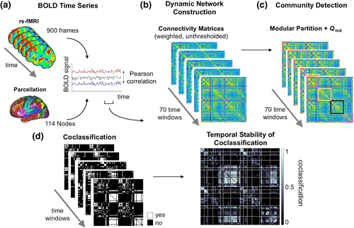
Notes:
Multiband fMRI data was acquired during resting state. Node parcellation is based on 114 subdivisions of the 17‐network Yeo atlas (see Section 2). Edges were modeled on the basis of Pearson's correlation coefficients between node‐specific BOLD time series for 70 time windows of 156 time points. (b) Weighted unthresholded connectivity matrices were computed for each time window. (c) Community detection was performed on each connectivity matrix. (d) Left: window‐specific coclassification matrices indicating whether a node pair is assigned to the same module (white) at a given time point. Right: connection‐specific stability values were calculated as proportion of time windows in which two nodes are coclassified to the same module. High values (white) indicate that the nodes of a pair are assigned consistently to the same module (exhibiting stable consistent module affiliation). Low values (black) indicate that a node pair is only rarely coclassified to the same module; rather, nodes stay consistently segregated from each other which may be interpreted as “stable absence” of segregation. Q _{ind} , global modularity of individual‐specific module partitions. fMRI, functional MRI [Color figure can be

Slide 12
Aims of the project
Compute metrics able to reflect normal brain organization fluctuations (i.e., change in the modular partition) over time using graph theory
Investigate sex differences and/or age-effects on brain network dynamic
Open-access data: Human Connectome Project: 90 subjects with MEG

